Slide 2
Who Are We?
An Advanced Technology Company
We seek to improve the health, wellness, beauty and longevity of every person we encounter
With no drugs, pills, opioids or injections
Our patented, wearable technology harnesses the power of light to boost health at the cellular level
The results… seen and felt… are astounding

Slide 3
Who Are We?
An Advanced Technology Company
Product distribution began in 2004
Warehouses now in 12 countries; distribution worldwide
Messaging in as many as 9 languages
We’re growing fast. Tens of thousands believe in our mission… and you?

Slide 4
Ask Yourself This
Are you satisfied …
With your health and how you look and feel?
Where you are with your finances?
How you see your future unfolding?
If you answer no to any of these, you are not alone.
And if you know others who would answer the same…
You are in the right place... at the right time…
with the right opportunity

Slide 5
We’re Expanding
With products that people need
Wearable technology, in patch form
Affordable, safe, non-invasive, non-drug
A patented form of phototherapy
Each patch uses light to increase or improve specific, naturally-occurring cellular action
With an opportunity to spread the word…
and to build with us

Slide 6
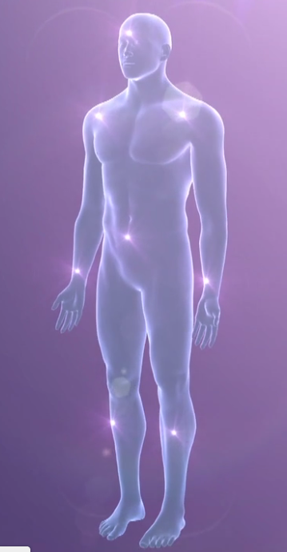
First: How LifeWave Technology Works
Watch our video on our patented phototherapy

Slide 7
Unique Products
Exclusively protected by multiple patents
Over 80 research and clinical studies
Independent researchers and universities
Medical and scientific experts

Slide 8
Unique Products
All patches are available in occasional-use or 30-day supply “Sleeves”
Member / Team-builder retail margins can be as high as 55%
Safe, non-drug, non-invasive patches you just place on your body. Nothing goes in your body.

Slide 9
Unique Products
There is a vast market for our products
Increased energy and endurance
Safe and natural pain relief,
Enhanced quality of sleep
Reduced stress
Immune system support
Appetite control
Looking younger, feeling stronger
Performing better, healing faster
No drugs, chemicals, stimulants or side effects

Slide 10
Our Patch Technology is Incredibly Effective
“The healing is remarkable… I believe I won’t even have a scar...”
“For the first time in a year my knee is not hurting…”
“No pain… more energy… better sleep…”
“Your tech has given me my life back!”
“Improved vision… greater clarity…”
“My husband says I look a lot younger…”

Slide 11
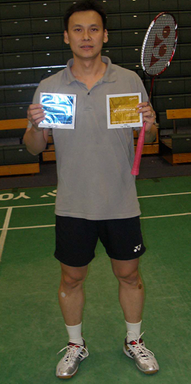
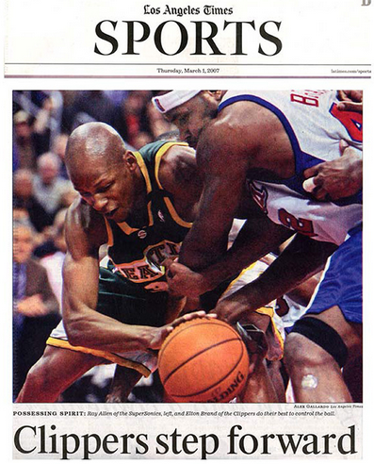
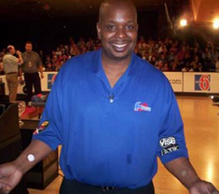
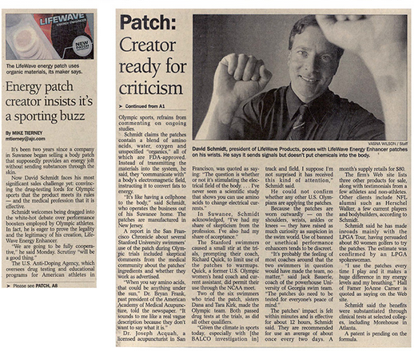
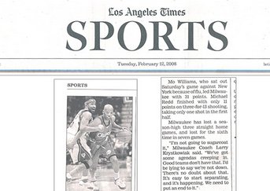
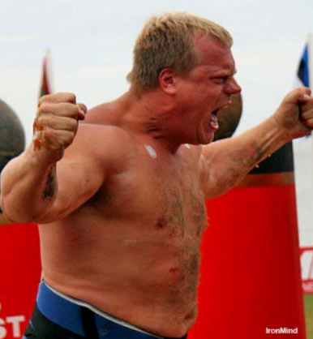
The Word is Out
Pro and Amateur Athletes… All Sports… Use Our Technology
All Types of Media Have Noticed!

Slide 12
And Now: Our Latest Blockbuster - X39®
Welcome to the
Stem Cell Revolution!
Your timing is perfect…
LifeWave X39® Activates Stem Cells (details in a second)
You can help us tell the world!

Slide 13
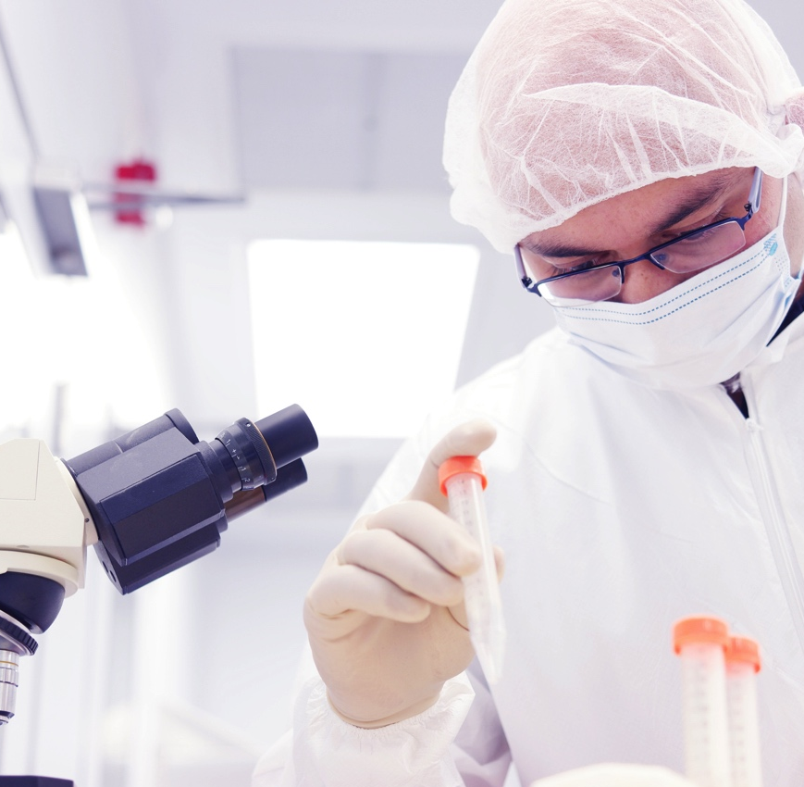
X39® - A Game Changer
Fast-Growing Market
Billions already being spent on stem cell research and treatment
Demographics are in our favor… the world is getting older
Stem cell injections are expensive and often unsafe
X39® is affordable, safe and non-invasive

Slide 14
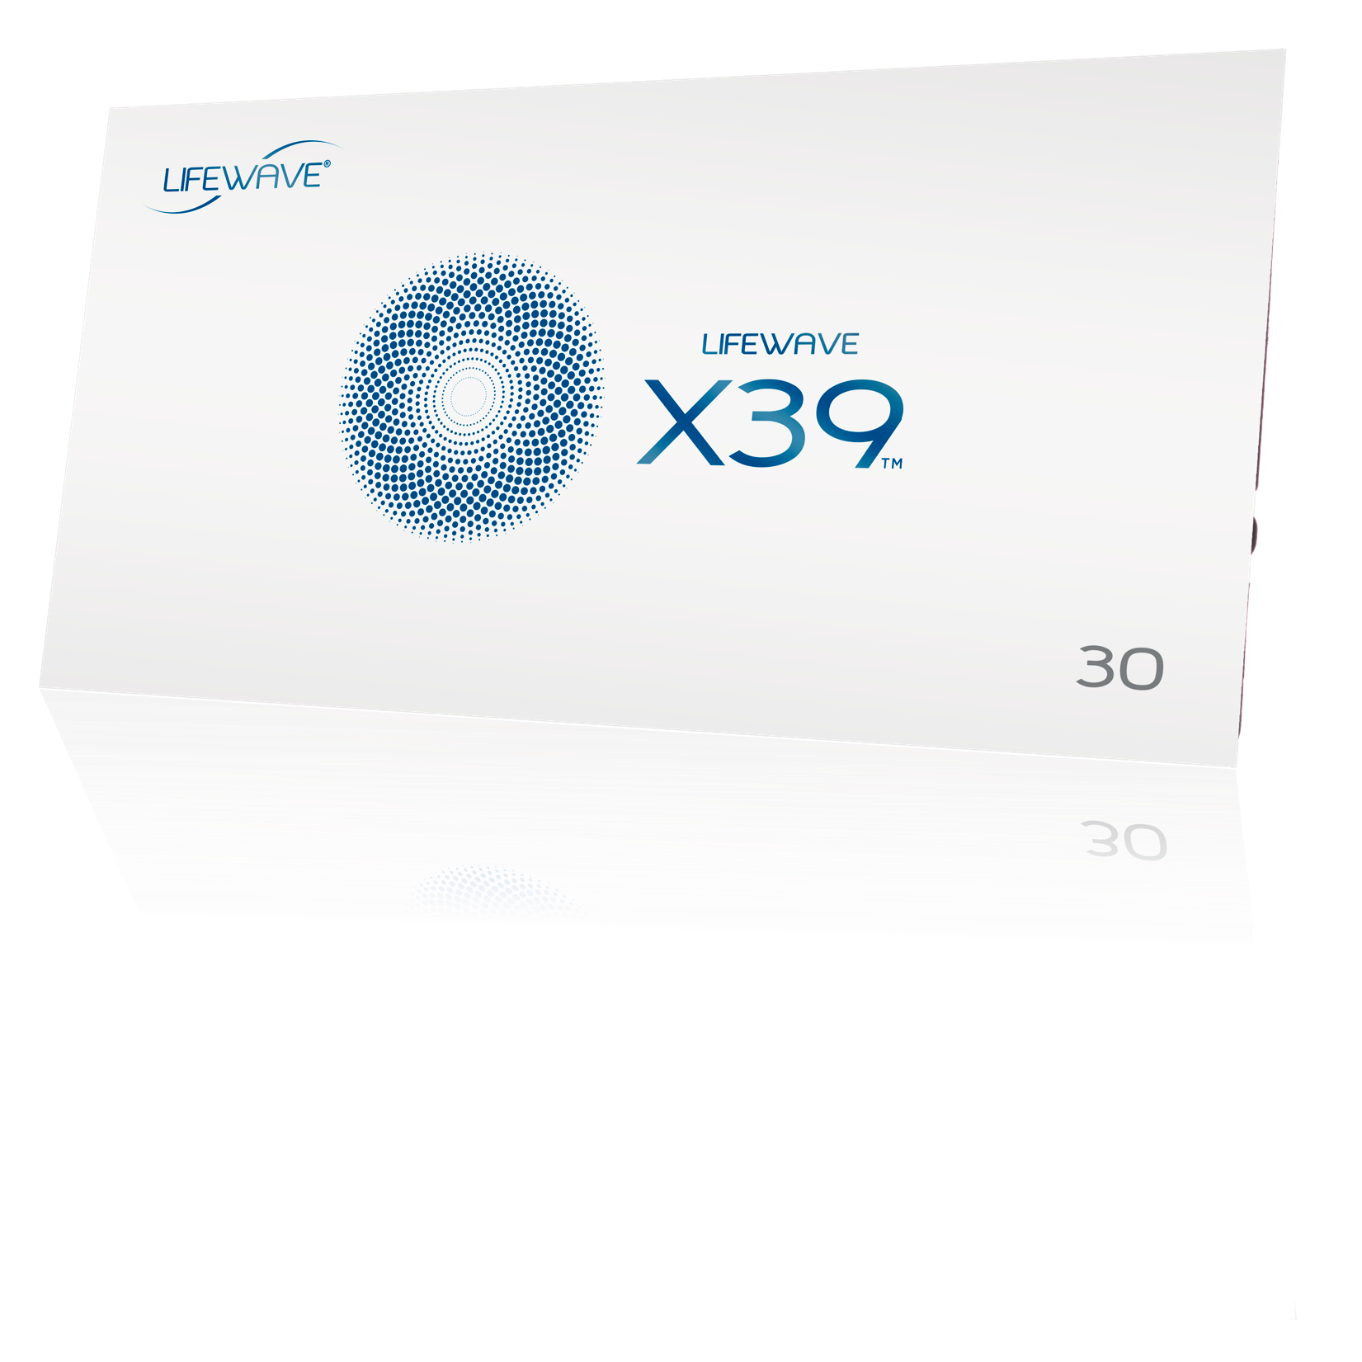
X39® - A Game Changer
X39® Activates Stem Cells -
A True Breakthrough
Inventor, Founder, CEO David Schmidt:
“…my greatest achievement yet.”

Slide 15
X39® - A Game Changer
Right Place • Right Time • Right Product
Watch Our X39® Video

Slide 16
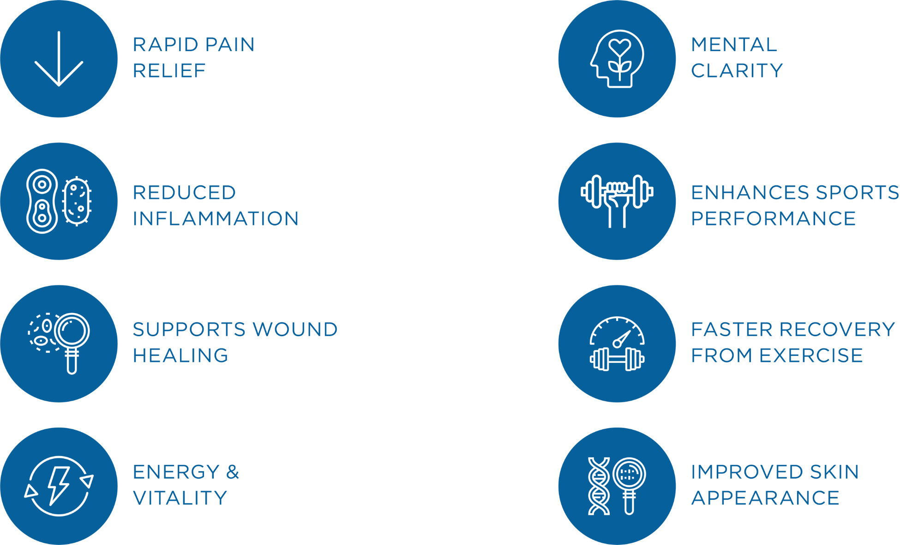
X39® - A Game Changer
See and Feel the Power!

Slide 17
Think About It
LifeWave performance drives word of mouth… the best form of advertisement
You tell others about a great restaurant… or a great movie…
Now you can earn money telling others about LifeWave: the tech and income opportunity - fueled by science with no competition

Slide 18
This is a True Opportunity
It’s Simple
Become a product of the product
Using X39® and other LifeWave products, is believing
Tell others of your experiences and let them try it, especially X39®
You’ll develop customers; some will
join your team to build with you

Slide 19
This is a True Opportunity
Possibilities are unlimited
The power of duplication leverages your time, generating residual income as your customer base increases and your team expands
Step-by-step guidance, marketing tools and training are always available

Slide 20
Corporate Handles Virtually Everything
Corporate Handles Virtually Everything
Clinical research
Product development / registration
Manufacturing
Supply chain logistics
Order fulfillment from 12 countries
Customer service
Product Liability Insurance
Intellectual property

Slide 21
Corporate Handles Virtually Everything
The LifeWave APP for on-the-go learning
and sharing
Your own website maintained for you
Professional videos, brochures, packaging, branded tools that you
can put to work now
Basic & advanced training to help
you grow as fast as you want

Slide 22
Corporate Handles Virtually Everything
Communications, product webinars, email updates
Suggested reading/listening tools for self-improvement
Promotions and incentives
Globally, all compensation is automated, paid weekly, electronically

Slide 23
Quick Summary: 6 Ways to Make Money
Profits from Retail Sales
(We’ll also drop ship to your customers and pay you
on those orders weekly)
Product Introduction Bonus
(Immediate reward for purchases made by new team members)
Matching Bonus
(% of weekly revenue earned by your personal team members)
Binary Bonus
(% of business volume your entire team generates)
Exclusive member incentives
(Trips, cash and prizes rewarded for performance)

Slide 24
Next Steps
Get Started!
Decide on your initial commitment
(Diamond - best value; Gold - most popular)
Start using X39®
(Your authentic experiences become part of your story)
Download the APP
(Always with you. Terrific for learning on-the-go and showing others)
Set-up Smart Delivery AutoShip
(Never run out… Also assures eligibility for additional bonuses and added revenue streams)

Slide 25
Next Steps
Get Started!
Know anyone that could benefit from our technology?
(Of course you do!)
Know anyone looking for added income and ready to see what you’ve discovered? (Of course you do!)
Make a list – think networking
(Who do you know and who do they know? Don’t pre-judge their interest)
Show – Share – Connect: Invite others to learn more
(Become informed on growth strategies for building a network of customers / members)

Slide 26
Next Steps
Become Informed… Engage!
Read Splash Articles
(Weekly updates, information, training, recognition from LifeWave corporate)
Attend Live Webinars
(Product knowledge and business training… invaluable!)
Your Back Office: a great resource!
(Loaded with information to help you increase product knowledge and gain insights for business-building success)
Your Website: Lifewave.com/you
(Plenty to learn. You will want to know what’s featured when sending others there)
Live Events: Where the future is now and success is celebrated!
(Fun, informative, great team-building opportunities. Meet and hear from corporate leaders and guest speakers)

Slide 27
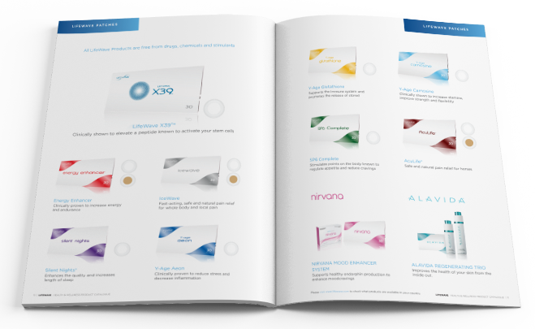
LifeWave and You: The Time is Now
We have what the world needs: Breakthrough Technology that helps people look and feel better. Join us… and help spread the word. Take advantage of the technology yourself and share it with others. Build a team of team builders and watch what happens to your bank account!
Live Long • Live Well • Live Younger
Sign up Today!

